Slide 1
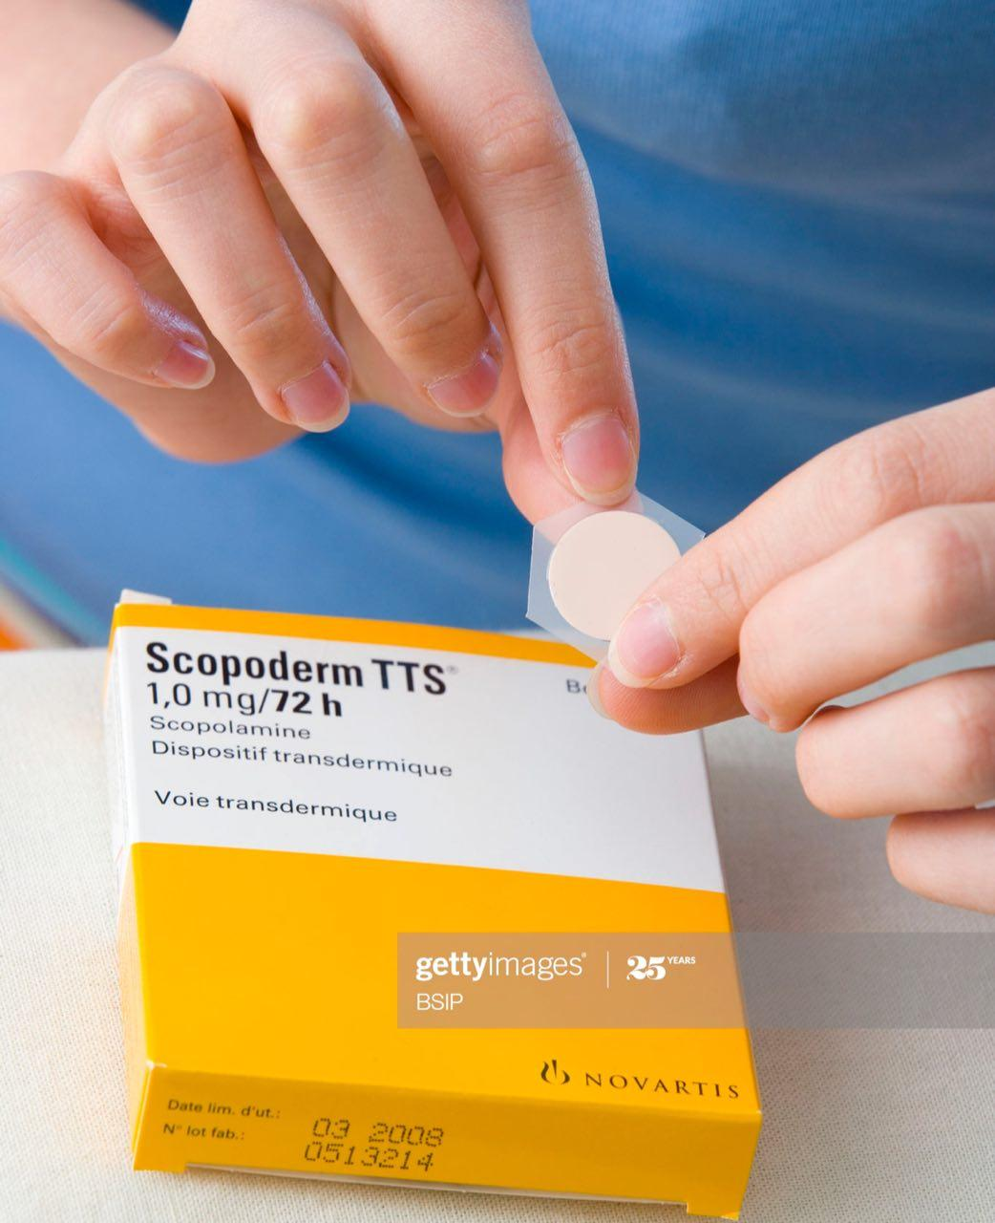
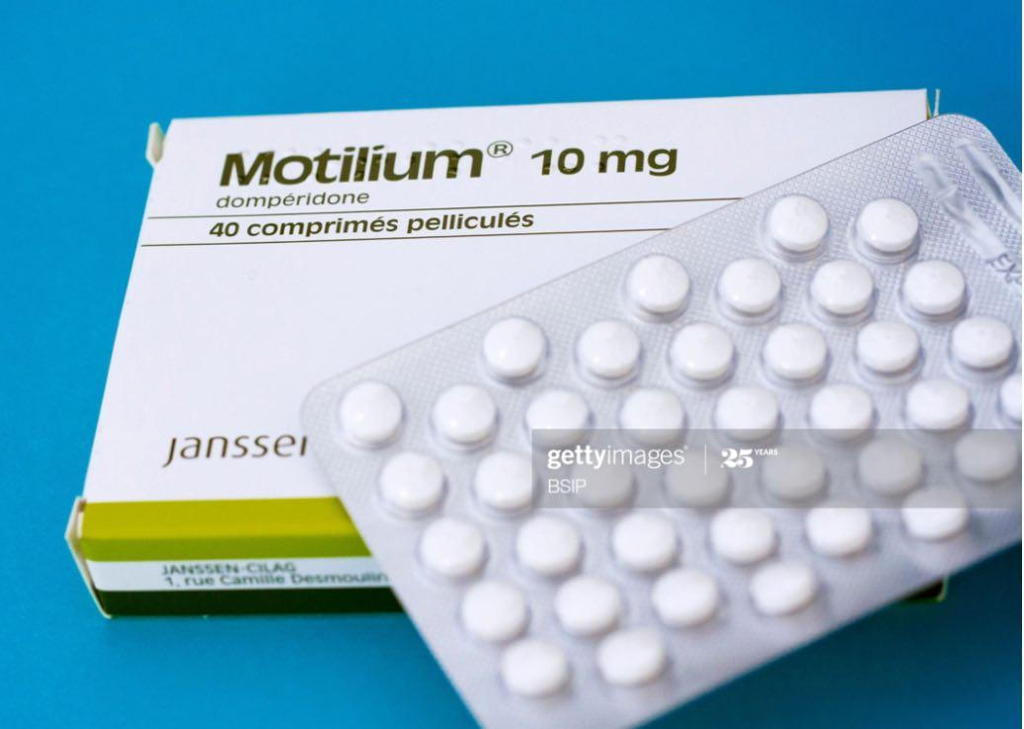
Antiemetic drugs

Slide 2
Antiemetic drugs
Used in vomiting due to different causes:
Motion sickness, pregnancy, GIT illness, and chemotherapy induced nausea & vomiting (CINV).
CINV influenced by several factors:
Type of anticancer drug: cisplatin ˃ MTX
Patient variables: young ˃ old, women ˃ men. Anticipatory vomiting 10-40%

Slide 3
Mechanisms that trigger vomiting
Two brainstem sites have roles in vomiting:
1. Chemoreceptor trigger zone (CTZ): it is outside BBB. Directly respond to stimuli in blood or CSF.
2. Vomiting center: also responds to afferent input from vestibular system & periphery (pharynx & GI tract). Vestibular system functions mainly in motion sickness.

Slide 4
Classification:
1. Antimuscarinic drugs: hyoscine, scopolamine
2. Antihistamines: cyclizine, meclizine
3. Dopamine receptors antagonists: metoclopramide, domperidone, prochlorperazine
4. 5-HT3 receptors antagonists: ondansetron
5. Other agents: corticosteroids, benzodiazepines
6. Neurokinin receptor (NK1) antagonist: aprepitant

Slide 5
Metoclopramide:
Acts centrally by blocking dopamine D2 receptors in CTZ. Metoclopramide antagonizes the emetic effect mediated by a dopamine receptor in the CNS.
It also raises the lower esophageal sphincter pressure and relaxes the pyloric sphincter, which hastens gastric emptying time.
This makes it useful in the therapy of reflux esophagitis.
Metoclopramide is metabolized by the liver with a half-life of 4 hours.

Slide 6
Uses
1. Nauseas and vomiting associated with gastrointestinal diseases
2. Cytotoxic and radiotherapy induced vomiting
3. In migraine to relief nausea & vomiting and increase absorption of analgesics
4. To empty the stomach in emergency anesthesia
5. Gastroparesis

Slide 7
Adverse effects
1. extra-pyramidal dystonia (torticollis, facial spasm, oculogyric crisis), more common in children and young adults (treated with benztropine or antihistamines)
2. Diarrhea (prevented by corticosteroid)
3. stimulation of prolactin release with gynaecomastia and galactorrhea

Slide 8
Domperidone
selective dopamine D2 receptors antagonist. The half-life is about 7 hours. It is used for the treatment of nausea and vomiting associated with gastrointestinal disorders, cytotoxic induced vomiting, & gastroparesis.
May cause gynaecomastia and galactorrhoea
Prochlorperazine
Act by blocking dopamine receptors in CTZ.

Slide 9
Ondansetron
Is a selective 5-HT3 receptors antagonist in CTZ & peripheral vesceral vagal fibers.
Ondansetron & granisetron are highly effective against nausea and vomiting by cytotoxic drugs and radiotherapy.
Cause constipation, headache and facial flushing
Safe in children & in pregnancy

Slide 10
Corticosteroids as dexamethasone & methylprednisolone
Also effective in cytotoxic drugs induced vomiting, probably act by reducing oedema in vomiting centers or PG blockade.
Combination with other antiemetics increases their activity.
Benzodiazepines: lorazepam & alprazolam
Useful in treating anticipatory vomiting

Slide 11
Neurokinin-1 antagonists
Aprepitant target neurokinin receptor in the vomiting center & block action of substance P.
Is indicated for highly or moderately emetogenic chemotherapy. Usually in combination with dexamethosone & ondansetrone
Effective for delayed phase (24 hrs) of chemotherapy induced N/V

Slide 12
Motion sickness
Drugs are more effective prophylactically
Scopalamine is used for motion sickness and postoperative N&V
H1-blockers: dimenhydrinate, cyclizine, meclizine(also for pregnancy & vestibular vertigo)

Slide 13
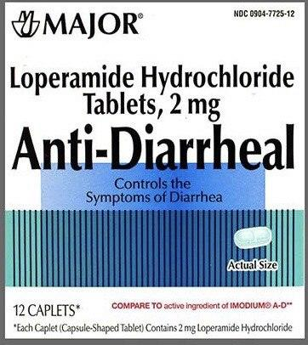
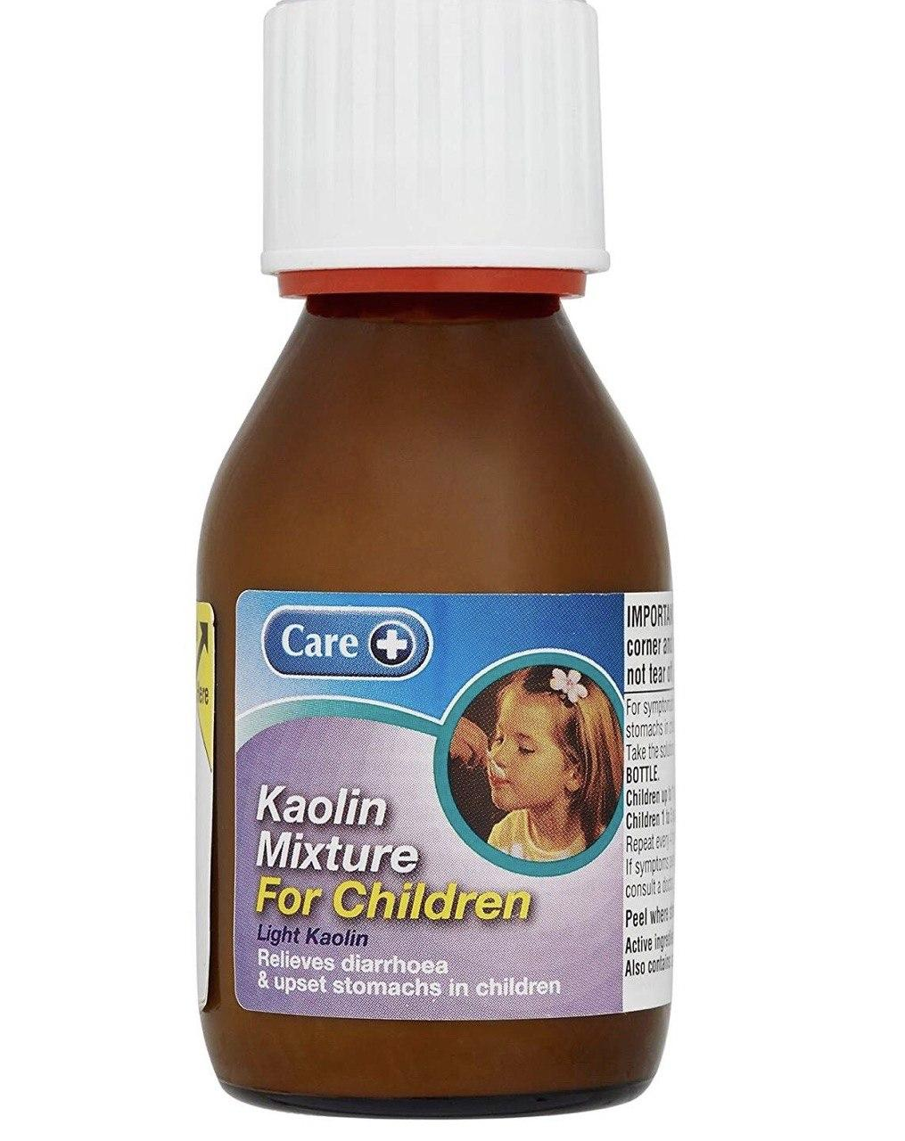
Antidiarrheal drugs

Slide 14
Antidiarrheal drugs
1. Antimotility drugs as: codeine, diphenoxylate and loperamide
2. Drugs increase viscosity of feces & as adsorbents: Kaolin & methylcellulose
Codeine:
Acts on the opioid receptors in the smooth muscles of the bowel to reduce peristalsis and increase segmentation contraction

Slide 15
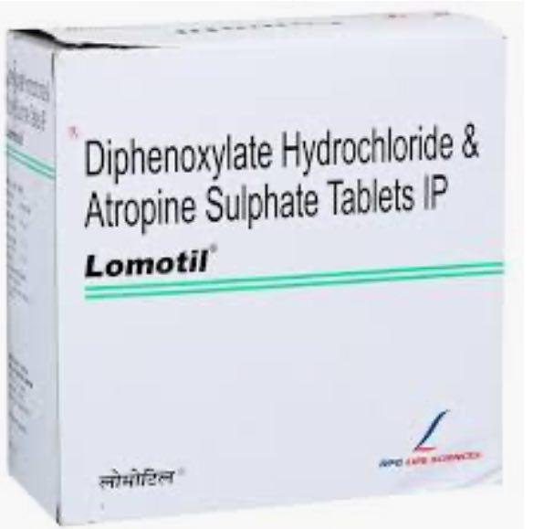
Diphenoxylate
Has an effect similar to codeine. Usually given mixed with atropine (Lomotil).
It causes nausea, vomiting abdominal; pain and CNS depression.

Slide 16
Loperamide:
Also an opiate act by inhibiting contraction of the smooth muscles of the intestine.
It also causes nausea, abdominal pain and vomiting.
All the anti-motility drugs should not be given to children with acute diarrhea as they may cause paralytic ileus and respiratory depression

Slide 17
Adsorbents
Aluminum hydroxide & methylcellulose are used to adsorb intestinal toxins or microorganisms and coating intestinal mucosa;
Bismuth subsalicylate used for traveler’s diarrhea.
Kaolin mixture used for children

Slide 18
MCQ
Metoclopramide has antiemetic properties because it
a. Accelerates gastric emptying time
b. Lowers esophageal sphincter pressure
c. Is a central nervous system (CNS) dopamine-receptor antagonist
d. Has cholinomimetic properties
e. Has sedative properties

Slide 19
MCQ
Extrapyramidal symptoms are side effect of which one of the following antiemetic drugs
Metoclopramide
Dimenhydrinate
Cyclizine
Ondansetron
Scopolamine
(A)

Slide 20
MCQ
A patient has to be urgently operated upon under general anesthesia; which drug can be administered to hasten gastric emptying?
Metoclopramide
Hyoscine
Promethazine
Ondansetron
Prochlorperazine
(A)

Slide 21
MCQ
A 55-year-old woman with type 1 diabetes of 40 years’ duration complains of severe bloating and abdominal distress, especially after meals. Evaluation is consistent with diabetic gastroparesis. Which of the following drugs could be used in this situation?
(A) Alosetron
(B) Cimetidine
(C) Loperamide
(D) Metoclopramide
(E) Sucralfate

Slide 22
MCQ
A patient is receiving highly emetogenic chemotherapy for metastatic carcinoma. To prevent chemotherapy-induced nausea and vomiting, she is likely to be treated with which of the following?
(A) Levodopa
(B) Methotrexate
(C) Misoprostol
(D) Ondansetron
(E) Sucralfate

Slide 23
MCQ
Metoclopramide has all the following features EXCEPT: ( c )
Acts by blocking dopamine D₂ receptors centrally
Increases the tone of the esophageal sphincter and relaxes the pyloric sphincter
Delays the absorption of analgesic drugs during acute migraine attack
Is useful in nausea and vomiting induced by cytotoxic drugs
May cause extrapyramidal dystonia in young patients

Slide 24
MCQ
One of the stated mechanisms is correct for anti-emetic drugs (b)
Ondansetron is agonist at 5HT3 receptors
Aprepitant is highly selective neurokinin (NK1) receptor antagonist
Nabilone acts mainly as dopamine D2 receptor blocker
Metoclopramide is a centrally acting dopamine agonist
Hyoscine is a centrally acting antihistamine

Slide 25
MCQ
The main clinical use of loperamide is:
Vomiting of motion sickness
Diarrhea
Reflux esophagitis
Constipation
Dyspepsia
(B)

Slide 26
MCQ
Which of the following drugs is used for treatment of diarrhea ?[b]
bisacodyl
diphenoxylate
senna
lactoluse
glycerol

